Slide 1


Online Shopping

Slide 2
Team Members

Slide 3
TEAM MEMBERS
Trainee
Trainee
Trainee
Trainee
Mai Huynh Trung Nguyen
LE TAN QUY
NGUYEN MINH THANH
NGUYEN TRONG HUY
Tcode: AMJ22052
Tcode: AMJ22040
Tcode: AMJ22043
Tcode: AMJ22044

Slide 4


GUIDED BY
Mr. Chandrasekhara Baratam
Mr. Balakrishna Palla

Slide 5
PROJECT INTRODUCTION
DIAGRAM
PRODUCT INTERFACES

Slide 6
PROJECT INTRODUCTION

Slide 7

PROJECT INTRODUCTION
Notes:
Online Shopping system is a web application that provides users with an online shopping platform to be able to shop for specific goods, clothes, without having to buy directly at the store.
This system manages complete all data in a single application and in a single database.
Users will use this system to purchase garments and order online.
The purpose of the system is to help users easily order and reach a wide range of users.

Slide 8
FEATURES
Provides users with a convenient way to shop
Manage the shopping details
Manage the payment details
Reduce the cost of management
Notes:
Provides users with a convenient way to shop.
Manage the shopping details: The whole system of online shopping manage the detail of each shopping done by the customers. They extract the product details of what consumers shopped.
Manage the payment details: In online shopping, customers get many options for mode of payments. Websites give them the option of online payment through debit or credit cards.
Reduce the cost of management: Online shopping or digital shopping help in reducing the management cost of products.

Slide 9

LIST OF MODULES
Admin: manage
User
Product
Order
Client:
View product
Profile
Order

Slide 10
PRODUCT FUNCTIONS
Login and Registration
Cart Management
Admin Management
Profile Management
Order Management

Slide 11





TECHNOLOGIES
JDK1.8
Eclipse IDE
Apache Tomcat 8.5
HTML, CSS, Java Script, JSP
Oracle 11g
Spring Boot with Spring MVC
Hibernate, Spring Data JPA
…

Slide 12
PROJECT DIAGRAM

Slide 13
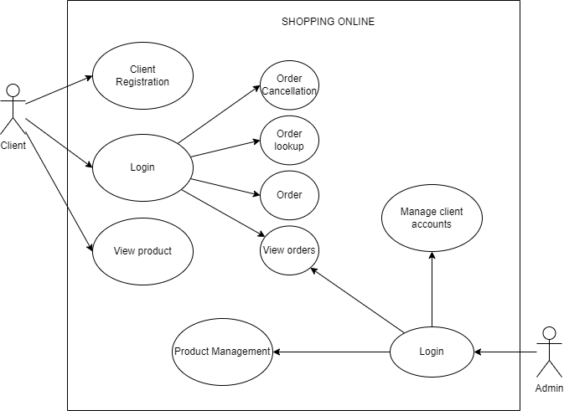
USE CASE DIAGRAM

Slide 14
ER DIAGRAM

Slide 15
ARCHITECTURE DIAGRAM

Slide 16
PRODUCT INTERFACES

Slide 17

LOGIN PAGE

Slide 18

REGISTER PAGE

Slide 19
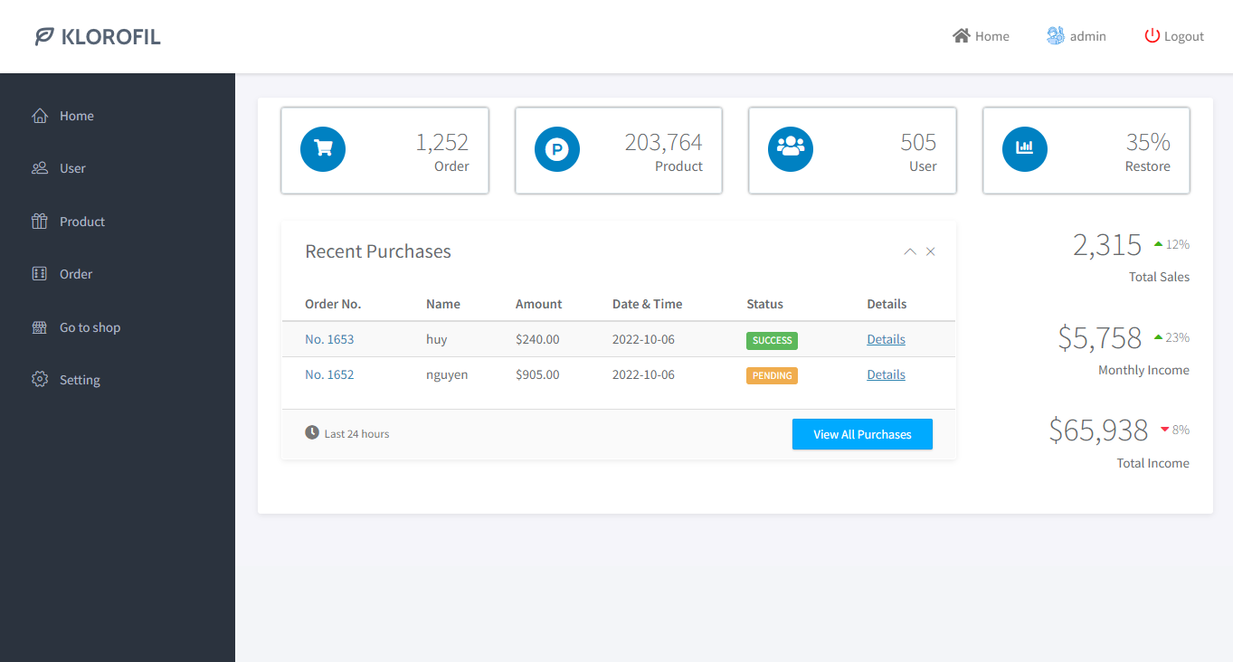
ADMIN HOME PAGE

Slide 20
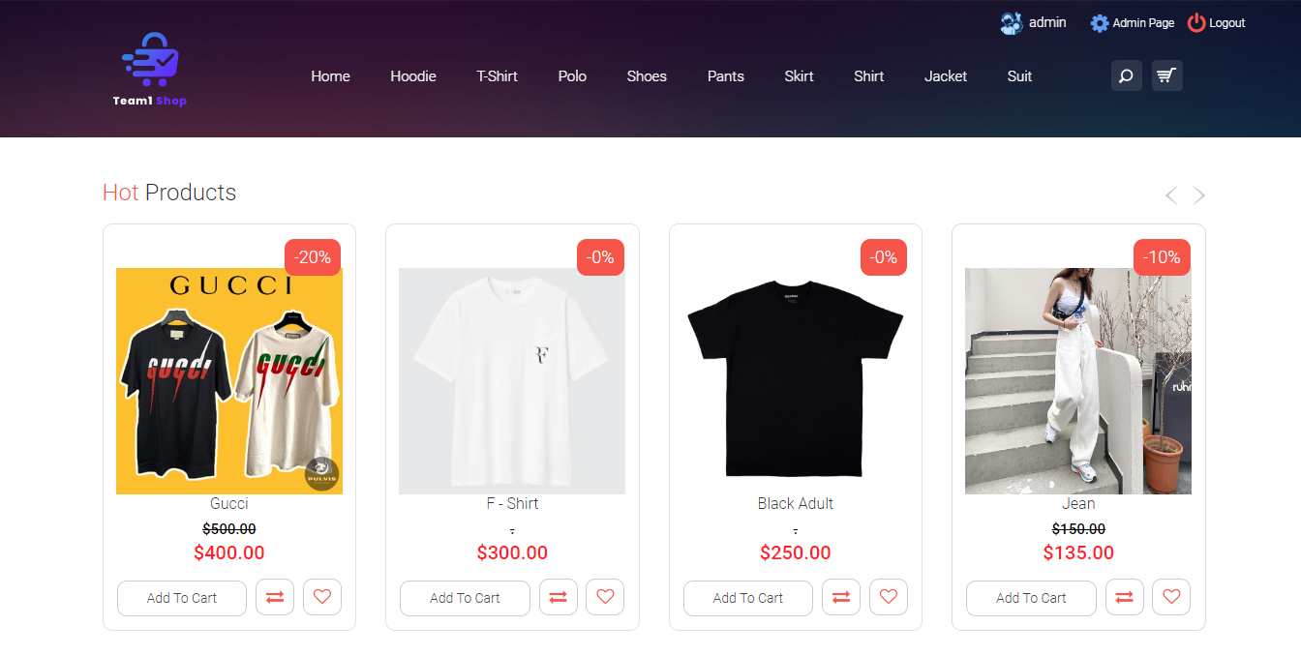
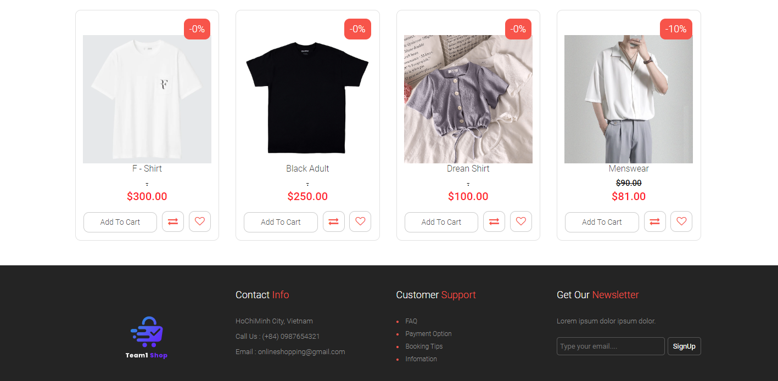
CLIENT HOME PAGE

Slide 21
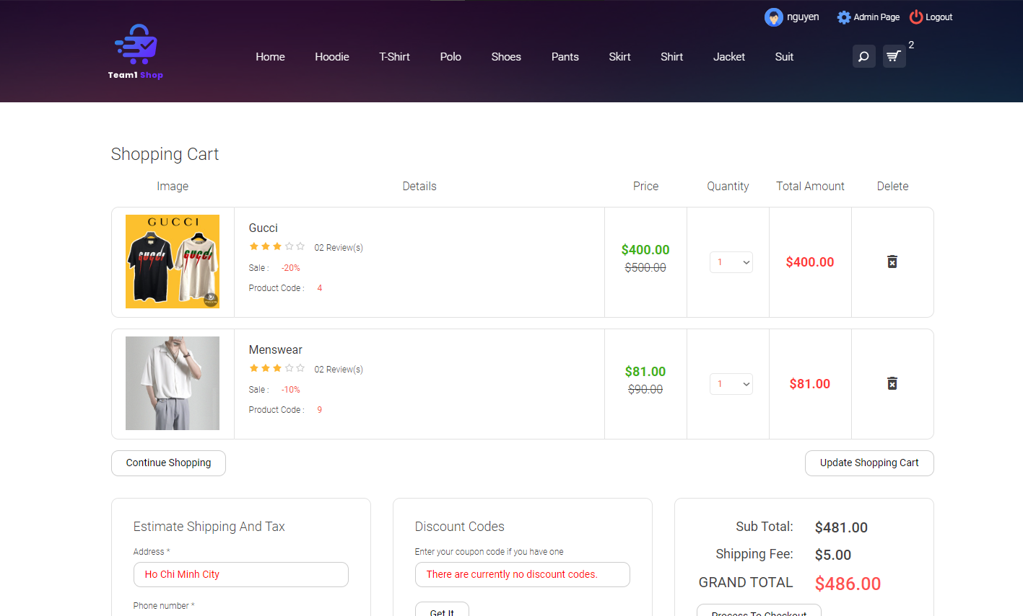
CART HOME PAGE

Slide 22
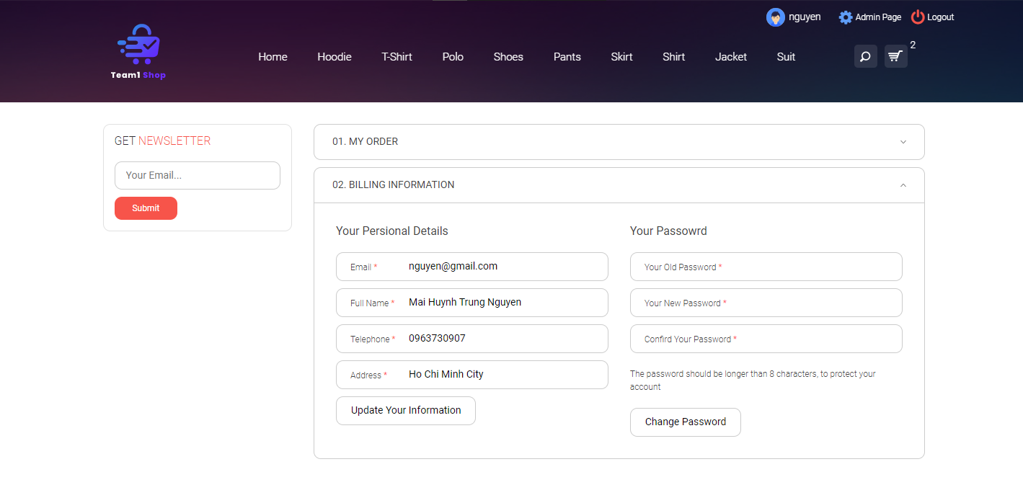
PROFILE PAGE

Slide 23
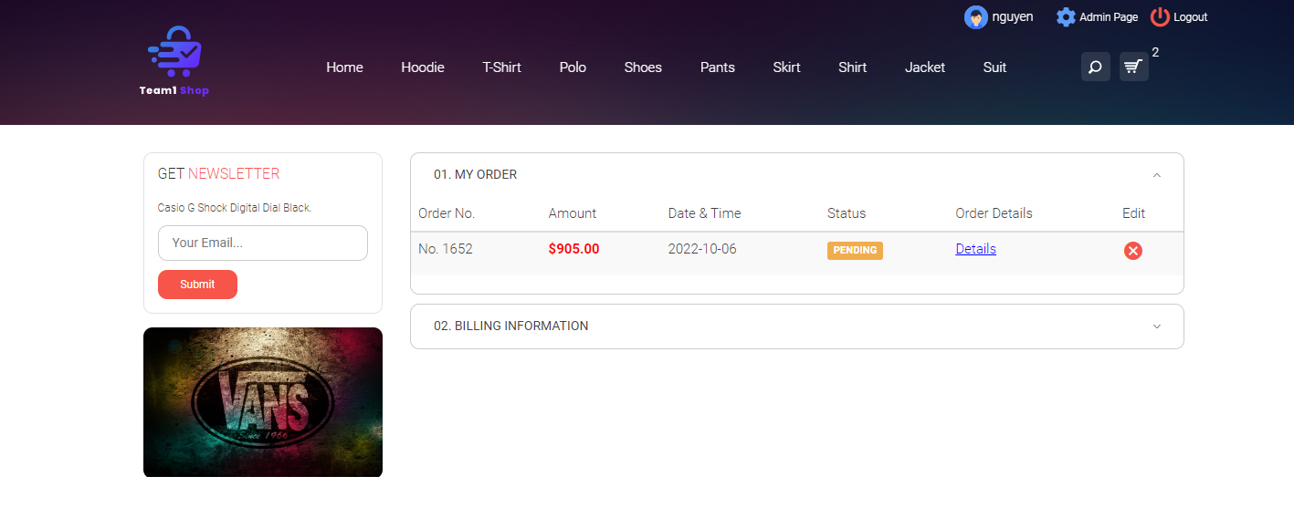
MY ORDER PAGE

Slide 24
THANK for listening!

Slide 25

Q&A

